Slide 1
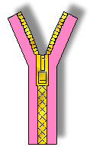
Lecture 23
Chemical Engineering for Micro/Nano Fabrication

Slide 2


Final Exam
When: Thursday December 13th from 9:00 am – Noon
Where: ETC 2.114
Bring Pencil, eraser....no calculator.
Corrected Exams will be available for you in NHB 5.136 after the grades are posted.

Slide 3

The Big LER Trade Off

Slide 4
Comparison of ArF and KrF
Typical KrF system always shows moderate variation of DR……
Typical ArF system always shows dramatic variation of DR……
Moderate Rmax
Uniform DR inside film
Quite high Rmax
Different DR inside film
Low contrast value
Suddenly the dissolution begins
The contrast is very high
Gradually increasing DR
No DR @ Unexposed area
0< DR @ Unexposed area
No DR changes until this point
Notes:
I will try to introduce the difference between KrF and ArF about dissolution behavior. Here is Dissolution rate variation of KrF. Normally, they have dissolution rate, more than zero, and the dissolution rate is accelerated by exposure. The contrast is low. The Rmax is not so high, and the dissolution rate in side film is unfirom. On the other hand, here is the ArF’s. they don’t have any dissolution rate at unexposed area, No dissolution rate changes until this point. And then the dissolution is suddenly coming, the contrast is too high. The Rmax is quite high, and the dissolution rate in side film is not uniform.

Slide 5
Dissolution behavior
DR
KrF System
This difference in the contrast amplifies small variations in the blend region. “Digital” On/Off switching phenomenon makes the line edge rough.
ArF System
Notes:
OK. I will try to show my image of dissolution behavior of KrF and ArF resists. For KrF, half components are phenol. So they have dissolution rate at unexposed area. And then, generating carboxylic acid accelerates dissolution rate faster. Finally, the rate reaches Rmax. On the other hand, for ArF, most of components are lactone, and no dissolution rate. Even though COOH generates a little, lactone doesn’t contribute to DR because it’s not sufficient to open ring. And then suddenly the switch turns on, dissolution begins, reaches Rmax. So this different in the contrast amplifies small variations in the blend region.

Slide 6
Is there such a thing as too much contrast?
The KrF system has lower contrast
Small fluctiuations cause small changes in dissolution rate..
DR
The ArF system changes from insoluble to soluble over a very narrow dose range
Small fluctuations are amplified and cause huge changes in dissolution rate.
Stochastic process noise becomes line edge roughness
Notes:
The dissolution of KrF is analog like. The deprotection accelerates the DR, but the acceleration might not amplify small variations. On the other hand, ArF’s is digital like. The enough deprotection is required, and the dissolution occurs suddenly. The dissolution might amplify small variations. So as my speculations, LER reducing may require a polymer which has some dark film loss, like Phenol. That structure developed for 157 might be useful for this issue. What is that structure?? Yes, HFA has dissolution rate, and might work like phenol.

Slide 7
Controlling LER is a big Challenge
There are many contributing factors.
  Stochastics in exposure (shot noise), mass transport, development, formulation heterogeneity, etc.
  In CA resists, LER is one member of the performance trade off known as the Triangle of Death.
  We will return to this issue soon

Slide 8
Can “it” be done again at 157nm???
Could have been
Perhaps….but
This time it would have been really hard!!

Slide 9
Absorption (μm⁻¹) of Common Polymers
Transmission
0.00001%!!!
Wavelength (nm)
157.6 193 248
248 resist 6.84 0.37
193 resist 6.86 0.47
Polystyrene* 6.20
Polynorbornene* 6.10
PMMA* 5.69
Fluorocarbon* 0.70
Vacuum UV
O₂, H₂O absorbs at this wavelength
Even hydrocarbons like butane and polyethylene absorb strongly
* R.R.Kunz,et al., Proc. SPIE 3678, 13 (1999).

Slide 10
Absorbance of Fluorinated Polymers
(2.68 μm⁻¹)
(5.42 μm⁻¹)
(6.02 μm⁻¹)
(2.44 μm⁻¹)
(1.15 μm⁻¹)
Hexafluoroisopropyl and α-trifluoromethylcarboxylic acid
are groups surprisingly transparent!

Slide 11
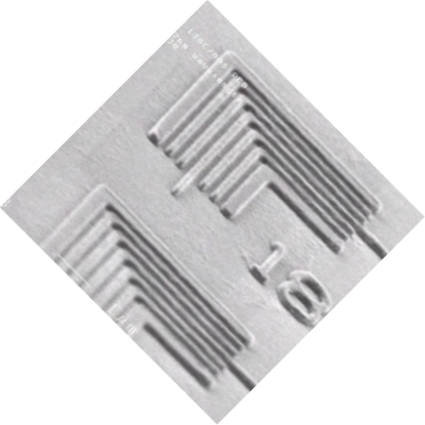

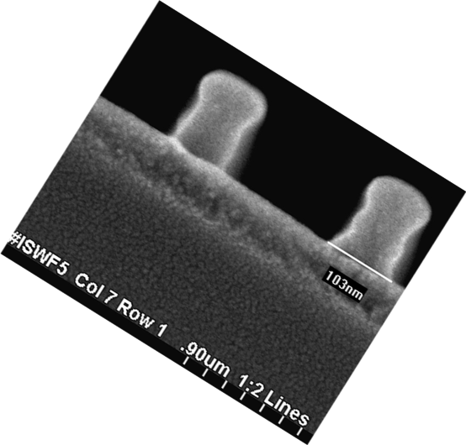
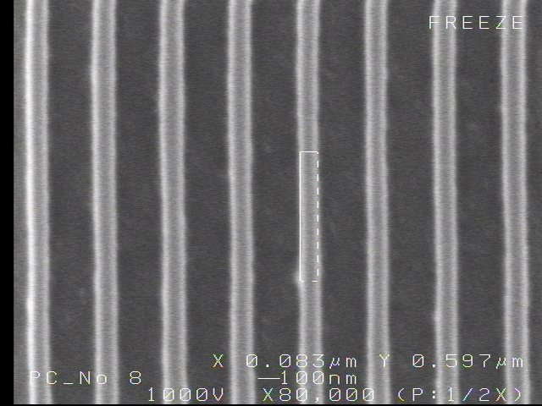
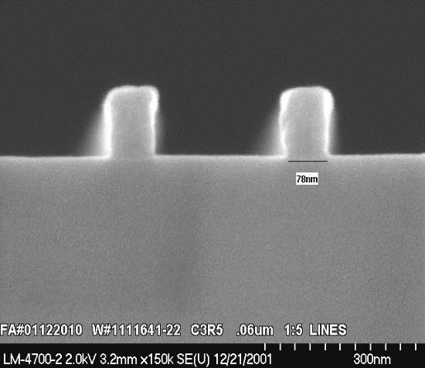
Images in UT 157nm Resists
70nm
Intel Announcement
Issues include: Pace, Resist, Pellicles, CaF₂, Birefringence, Cost, etc.
85nm
60nm
90nm

Slide 12
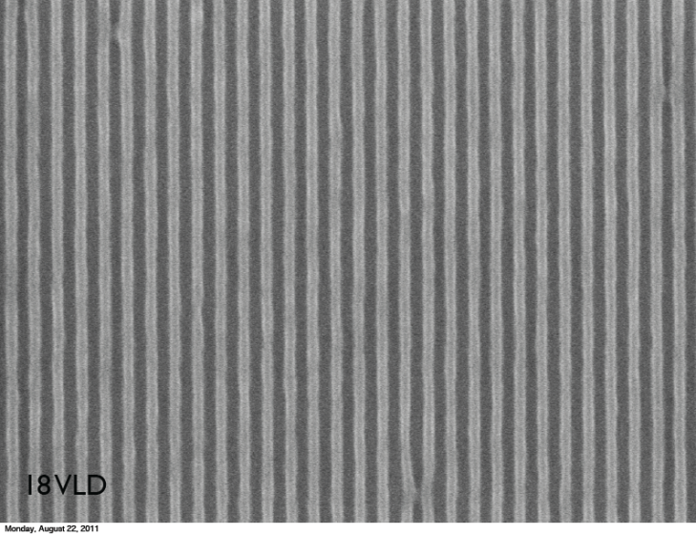
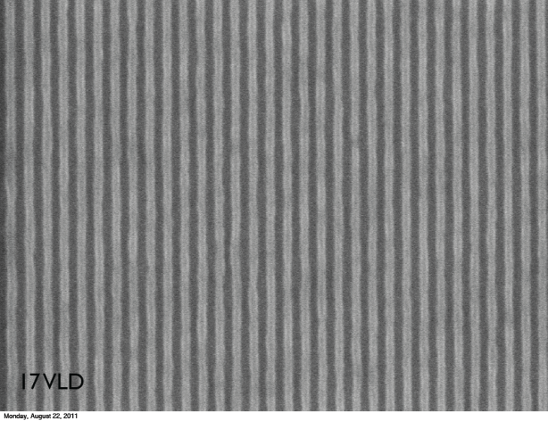
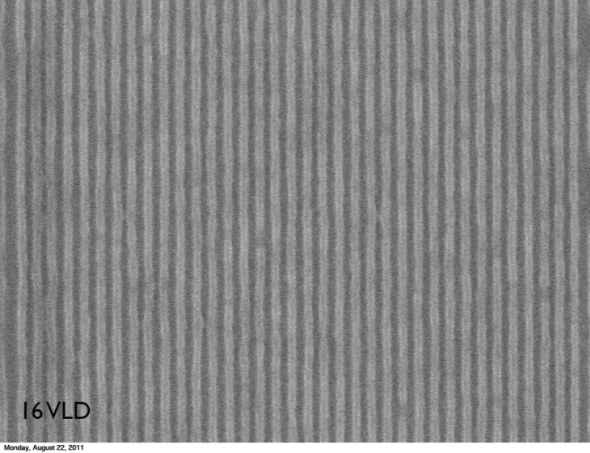
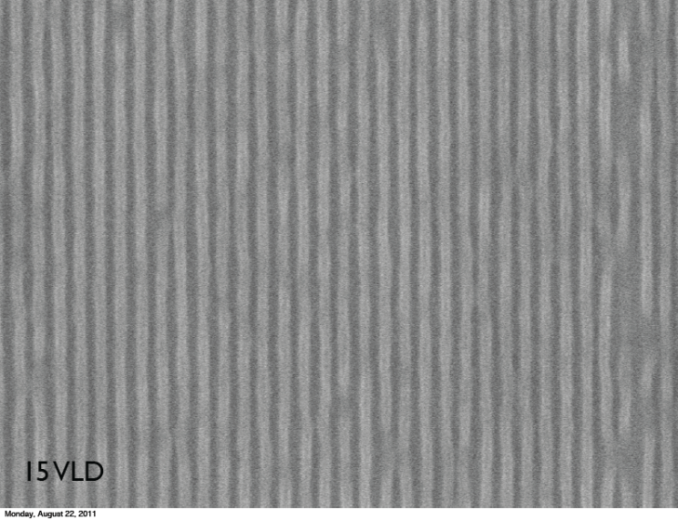
EUV Resist Progress
30mJ/cm2
MET@LBNL
18nm LS
17nm LS
16nm LS
Ultimate resolution of EUV resists has been improved by optimization of resist materials, illumination optics and phase shift mask.
15nm LS

Slide 13
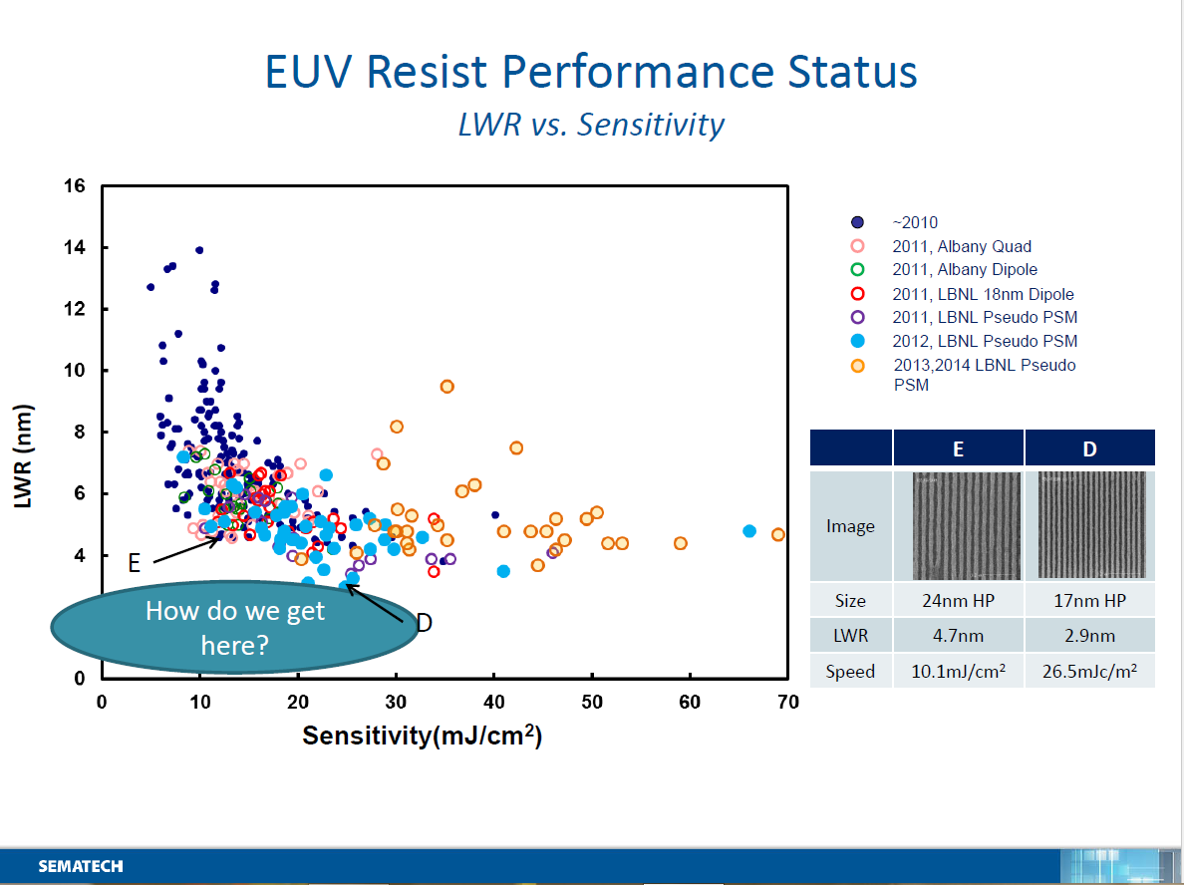

Slide 14
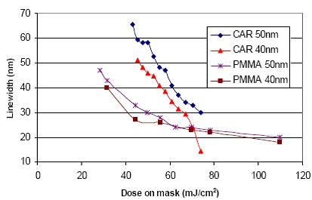
The Dose – resolution Trade off

Slide 15
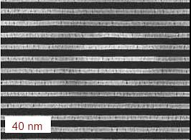
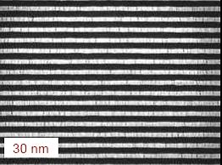
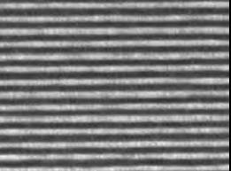
EUV Resist Resolution
EUVIL Test Results with PMMA
21.25 nm
Ref: H. Solak, Paul Scheerer Institute – MNE 2005, Vienna,

Slide 16

The Triangle of Death
The area of the triangle is “constant” for a given system
Sensitivity
Line Edge Roughness
Line Edge Roughness
Sensitivity
Resolution / blur
Resolution / blur

Slide 17
Can we Achieve Gain without Blur???
The catalyst is the culprit here…..
  Catalyst must move (diffuse) to achieve gain
  Movement (diffusion) causes bias and blur
  We can not escape this dilemma
Catalyst traps us in the Triangle…
  we must find a non-catalytic system with gain to escape

Slide 18
An approach to breaking out of the triangle
Based in unzipping polymers

Slide 19
Can we Achieve Gain without Blur???
The catalyst is the culprit here…..
  Catalyst must move (diffuse) to achieve gain
  Movement (diffusion) causes bias and blur
  We can not escape this dilemma
Catalyst traps us in the Triangle…
  we must find a non-catalytic system with gain to escape

Slide 20

Can Escape from the Triangle of Death?
We are exploring systems that achieve gain through exploiting “unzipping” polymers
  Design provides many chemical reactions/photon..Gain
  The reactions do not involve a catalyst
  Reactions are limited to a single polymer chain
    No interchain transfer of reactivity…. No diffusion blur!!

Slide 21
b
Requirements
Efficient unzipping in thin glassy films
Inherently sensitive to radiation
Thermally stable
Phase compatible with matrix polymer

Slide 22







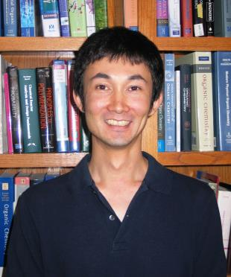
“Unzipping” polymers

Slide 23
Aromatizing Polymer
Monomer synthesis
Notes:
Carbodiimidazole—carbonyl imidazole

Slide 24
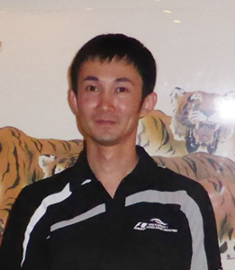
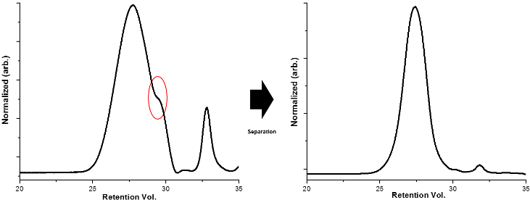
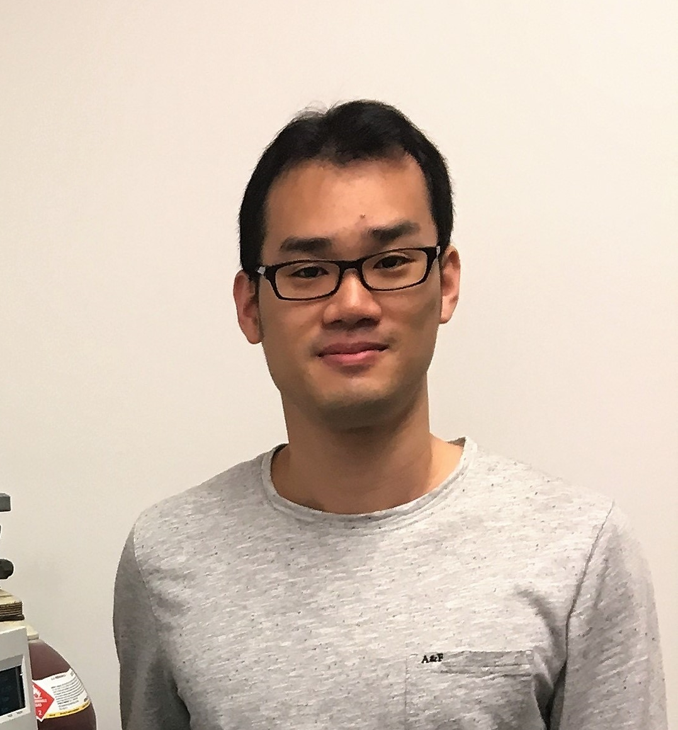
Polymer Synthesis

Slide 25
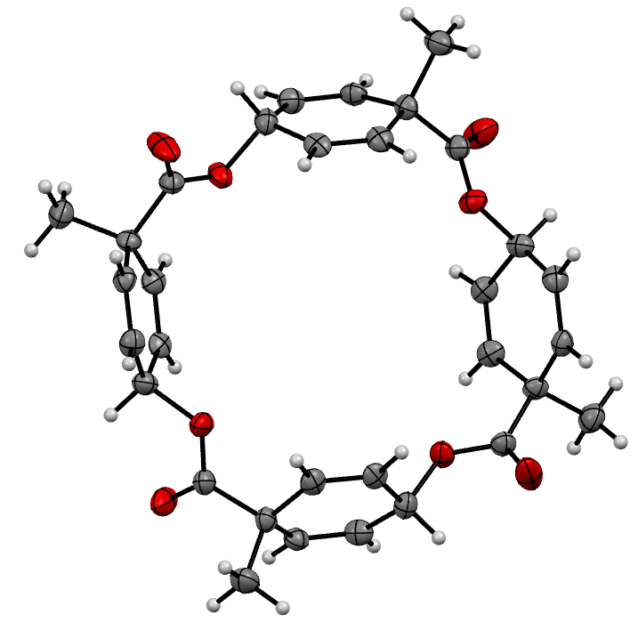
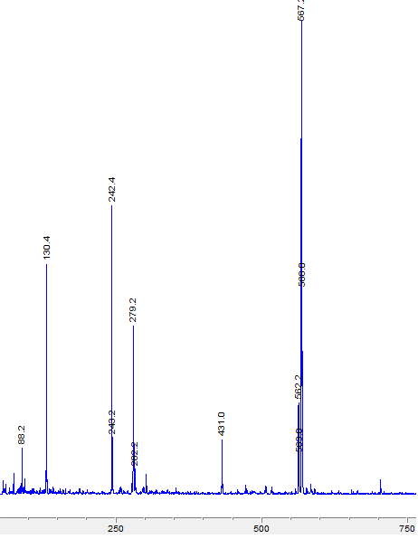
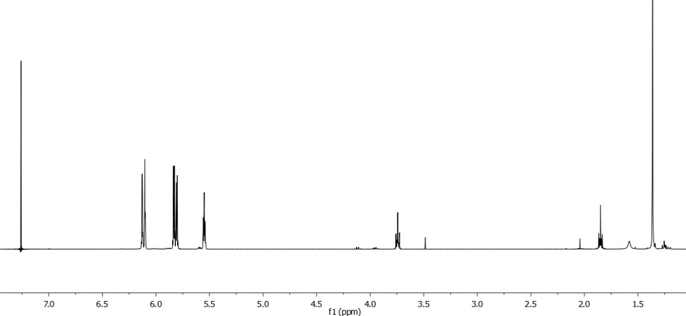
cis-Isomer gives a cyclic tetramer
Molecular Formula: C₃₂H₃₂O₈
Exact Mass: 544.21
+ 23 = 567.2
X-ray
Cyclic tetramer nmr

Slide 26
UV Exposure Study Surprise!!
12 h dark
1.5 h exposure
Unexposed
Solution quantum Yield (Φ) = 0.85 ± 0.04

Slide 27
Novolac/Diazoquinone Photoresists
I
I
I
I
I
I
I
I
I
I
I
I
Coat
UV
Substrate
UV
Inhibited Novolac (I)
Photoproduct (P)
I
I
P
P
P
I
I
P
I
I
P
P
P
I
I
Expose
Novolac
Substrate
LogR
I
I
I
I
365-nm exposure
I
I
I
I
Develop
Add DNQ
Substrate
I
Notes:
The first example -- Diazonaphthoquinone/Novolac chemistry.
These photoresists operate by taking the base soluble polymer, novolac and adding a small amount of a photoactive dissolution inhibitor, diazonaphthoquinone.
Adding the DNQ causes the dissolution rate of the resist to decrease by several orders of magnitude.
The DNQ acts as the photochemically solubility switch, such that upon exposure to 365 nm light, it’s converted to a carboxylic acid.
And this exposed resist has a higher dissolution rate than the novolac alone.
The result of this change in dissolution rate is a resist image with a nearly vertical sidewall profile.
Looking at this, you’d think that the perfect resist already exists .. And it does ... Unless you want to decrease the size of the image.

Slide 28
Gain without a catalyst
hν
I
I
I
I
I
I
I
I
I
I
I
I
Coat
Substrate
“unzip” Polymer
Monomer
UV
Resin Inhibitor
(I)
Photoproduct
(P)
I
I
P
P
P
I
I
P
I
I
P
P
P
I
I
Expose
Resin
Substrate
LogR
I
I
I
I
exposure
I
I
I
I
Develop
Add polymer
Substrate
I
Notes:
The first example -- Diazonaphthoquinone/Novolac chemistry.
These photoresists operate by taking the base soluble polymer, novolac and adding a small amount of a photoactive dissolution inhibitor, diazonaphthoquinone.
Adding the DNQ causes the dissolution rate of the resist to decrease by several orders of magnitude.
The DNQ acts as the photochemically solubility switch, such that upon exposure to 365 nm light, it’s converted to a carboxylic acid.
And this exposed resist has a higher dissolution rate than the novolac alone.
The result of this change in dissolution rate is a resist image with a nearly vertical sidewall profile.
Looking at this, you’d think that the perfect resist already exists .. And it does ... Unless you want to decrease the size of the image.

Slide 29
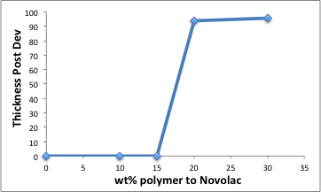
Dissolution Inhibition of m-cresol Novolac
Novolac
Unzip polymer

Slide 30

Etch performance for resist candidates
CF₄/CHF₃ etch chemistry
Novolak/Unzip formulation etches at a rate comparable to i-line resist.
PNBHFA/Unzip formulation etches at a rate similar to PMMA (193 nm) resist.

Slide 31
Contrast Curve Study
0
10
20
30
40
50
60 μC/cm²
+
Dose to clear
= 300 μC/cm²
Dose to clear
= 85 μC/cm²

Slide 32
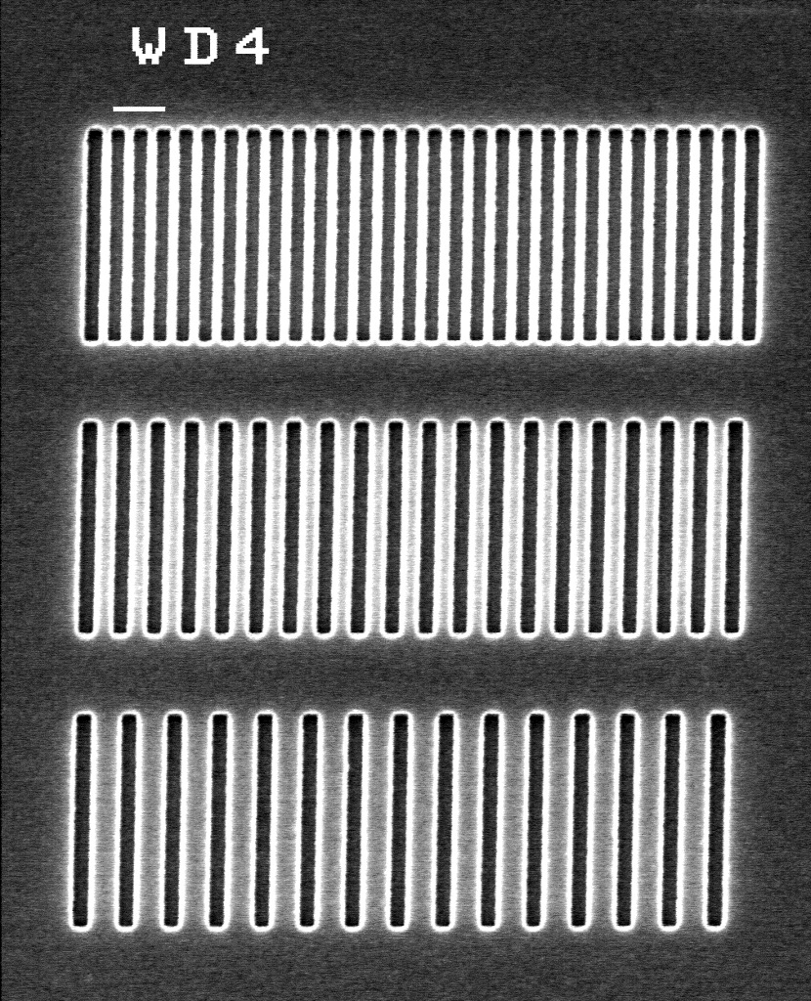
Sensitivity to electron beam radiation
100 nm line/space patterns made using Novolac/Unzip blend

Slide 33
Mn of unzip polymer affects resist performance
Mn_{unzip} = 2.5 kDa
γ = 2
D₀ = 115 μC/cm²
100 nm line/space patterns
Mn_{unzip} = 7.0 kDa
γ = 1.95
D₀ = 85 μC/cm²
Scale bar = 100 nm
PAB: 95°C, 1 min
Developer: 2.38% TMAH, 1 min

Slide 34

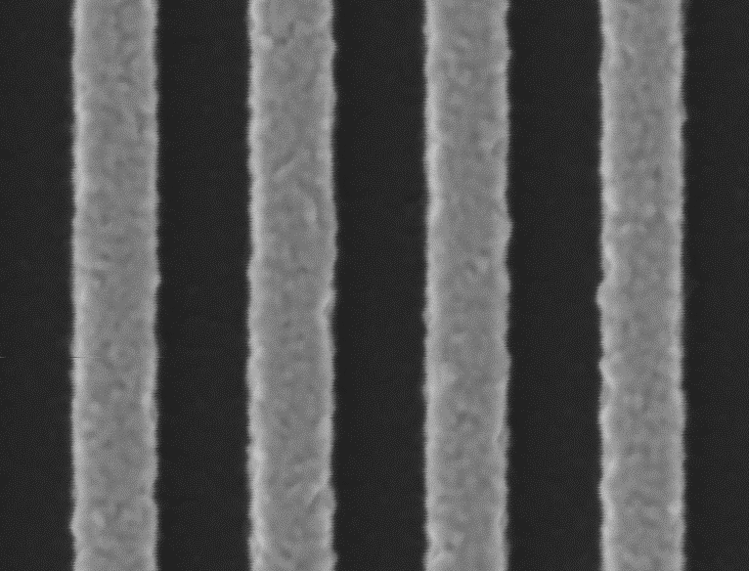
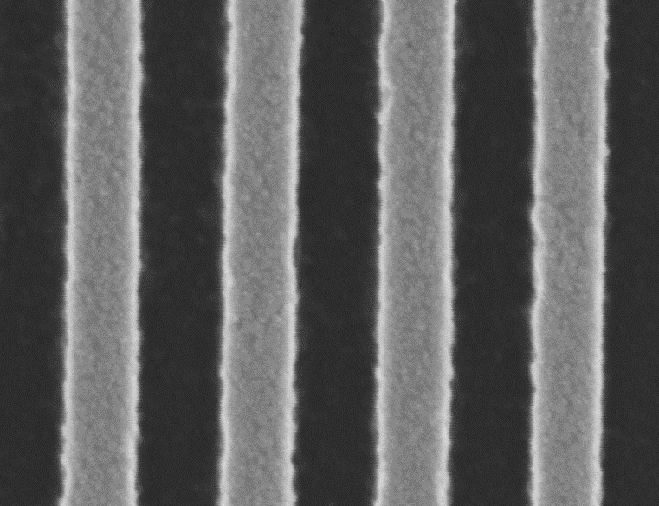
A resin other than novolac?
Poly(norbornene hexafluoroalcohol)
Novolak
120 μC/cm²
30 μC/cm²
Scale bar = 100 nm
15% unzip/85% Novolak, PAB = 95C
15% unzip/85% PNBHFA, PAB = 95C

Slide 35
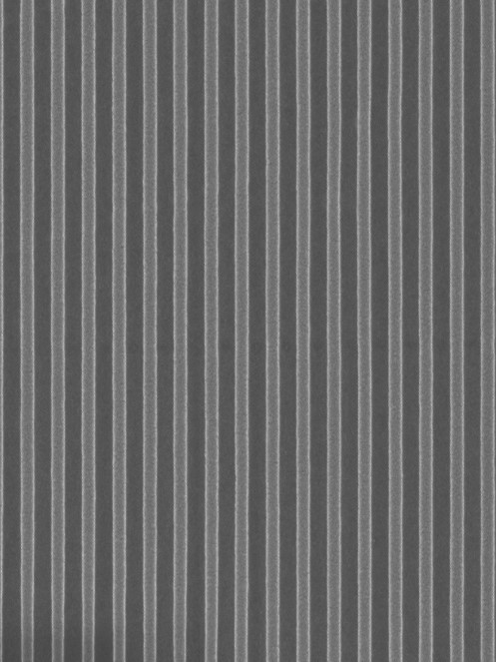
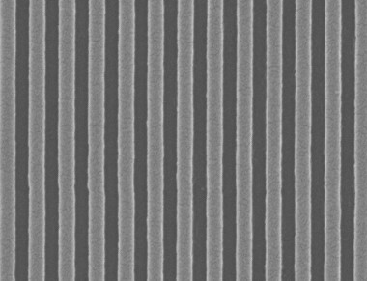

100 KeV exposure or 100 nm Lines and spaces at UMN
PMMA 450 μC/cm²
Unzip 30 μC/cm²
Acid Catalyst 145 μC/cm²

Slide 36
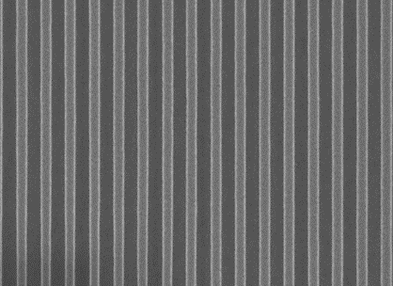
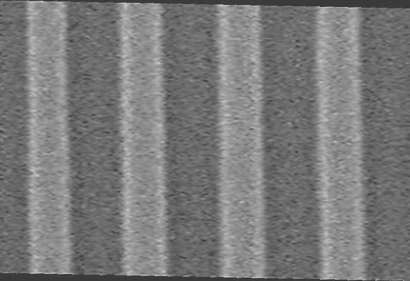
Ocular LER Analysis
PMMA
Unzip Resist

Slide 37

Have we escaped from the Triangle of Death??
Are we out??
Well…..Maybe……

Slide 38
E-beam Contrast Curve 100 KeV
Dose-to-clear 36 uC/cm²

Slide 39
EUV Contrast Curve (with Intel at LBL)
Dose-to-clear 1.6 mJ/cm²
Notes:
Megaposit MF-26A (w/ polyglycol)
Microposit MF -CD-26

Slide 40
Resist and Process Development
Basic
Chemistry
Formulation and Process Development
Optimization
Performance
Time

Slide 41
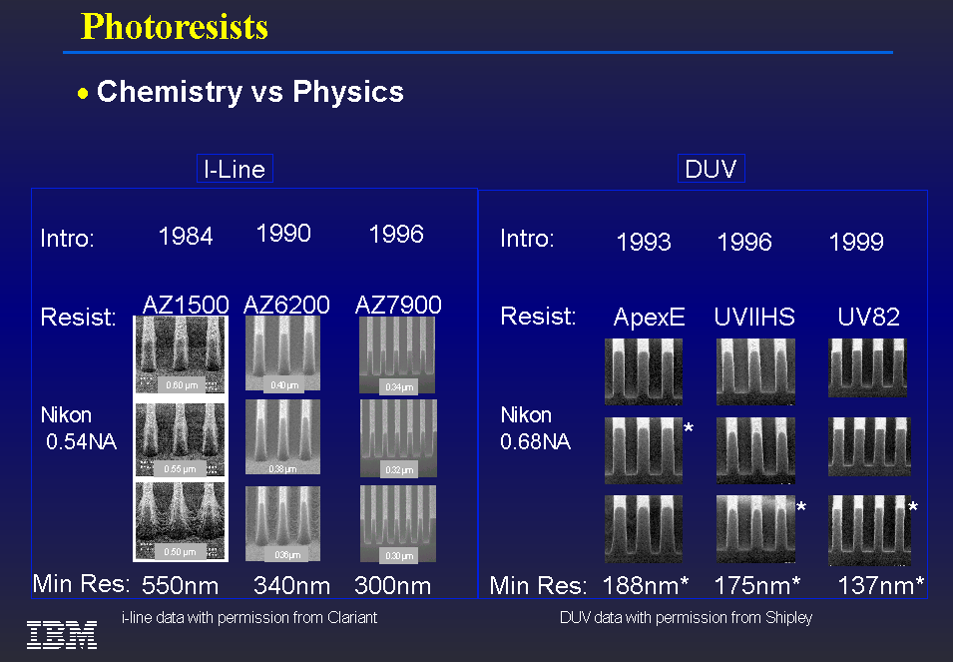
b
Performance Optimization Takes Time

Slide 42
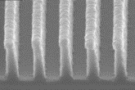
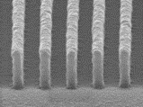
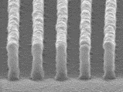
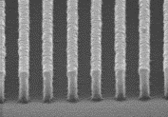
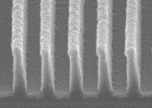
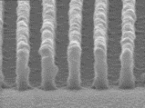
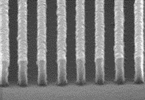
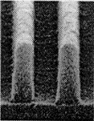
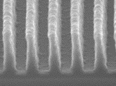
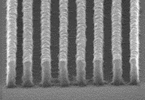
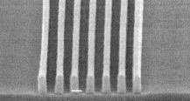

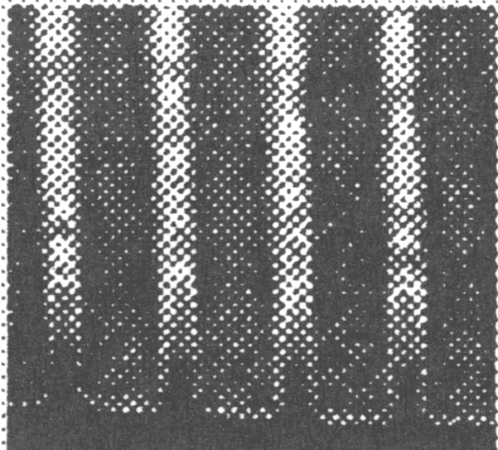
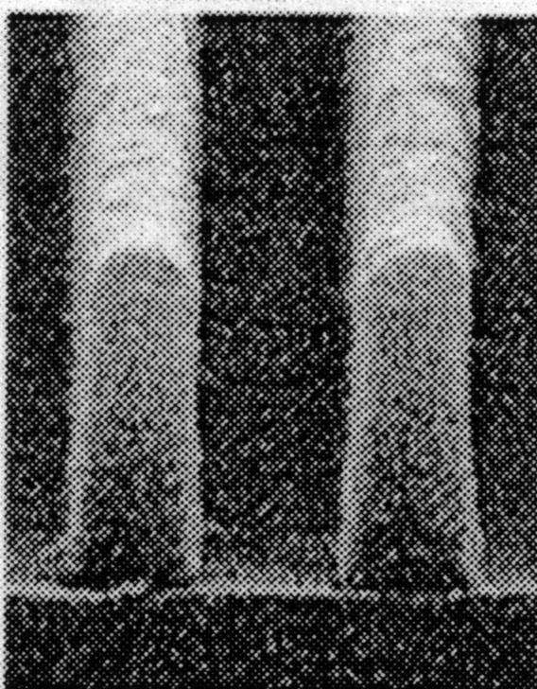
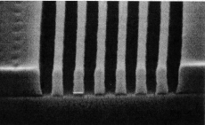
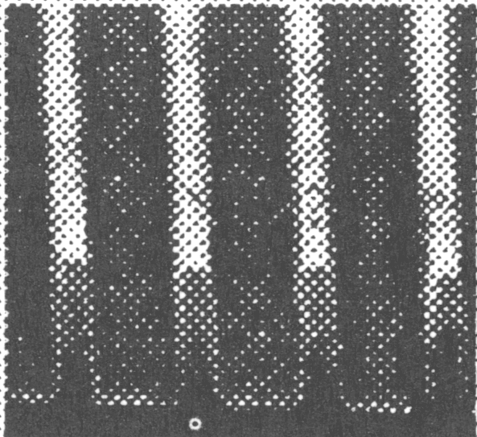
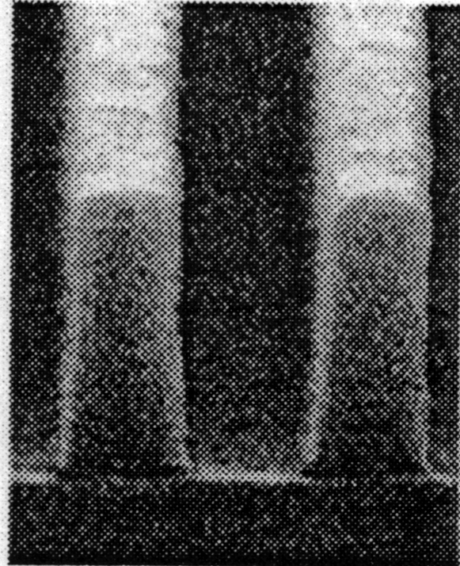
193 nm Resist Evolution
COBRA
AZ®AX™1000P
AZ®AX™1020P
COMA
150
140
130
nm
140
130
120
nm
160
150
140
nm
140
130
120
nm
170
160
145
nm
Version 2
170
160
nm
®

